Slide 1
Data-Link Layer
Course Code: COE 3201
Course Title: Data Communication
Dept. of Computer Engineering
Faculty of Engineering
Lecture No: | 12 | Week No: | 13 | Semester:
Lecturer:

Slide 2
Lecture Outline
Data-link layer Overview
Addressing mechanism
Link-layer addresses

Slide 3
TCP/IP layers
Reviewing TCP/IP model, we note that:
Application layer protocols facilitate the operation of the program used by user.
Transport layer classifies which server and which client programs are supposed to receive which data.
Network layer lets networks to communicate with each other through routers.
The data-link layer interprets physical layer signals and gets data to nodes in the same network.
Physical layer handles cabling and sending signals and specifies how signals are sent over connections.
Next topic
Discussed so far

Slide 4
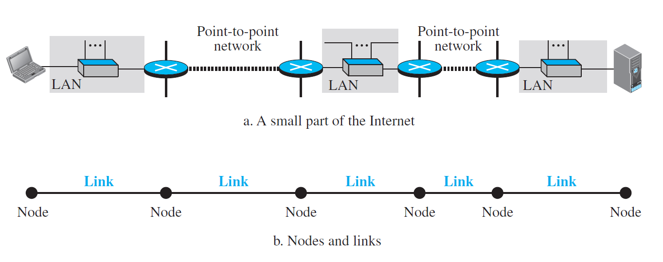
Nodes and Links
A data unit from one point in the Internet needs to pass through many networks (LANs and WANs) to reach another point.
Theses LANs and WANs are connected by routers. Each router takes input from one network and sends output to another network.
It is customary to refer to the two end hosts and the routers as nodes and the networks in between as links.

Slide 5
Communication in the Data-Link Layer
Communication at the data-link layer is node-to-node.
When a packet is travelling in the Internet, the data-link layer of a node (host or router) is responsible for delivering a datagram to the next node in the path.
The data-link layer of the source host needs only to encapsulate, the data-link layer of the destination host needs to decapsulate, but each intermediate node needs to both encapsulate and decapsulate.
A packet at the data-link layer is normally called a frame.

Slide 6
Addressing Mechanism for Data-Link Layer
During communication over Internet, each unit of data may take a different path from the same source host to the same destination host.
The source and destination IP addresses at the network layer define the two ends and should not be changed under normal circumstances, but they cannot define which links the datagram should pass through.
For this purpose, a data link layer address is needed that gets data to nodes in the same network. Data link layer address is called a MAC address or Physical address.

Slide 7
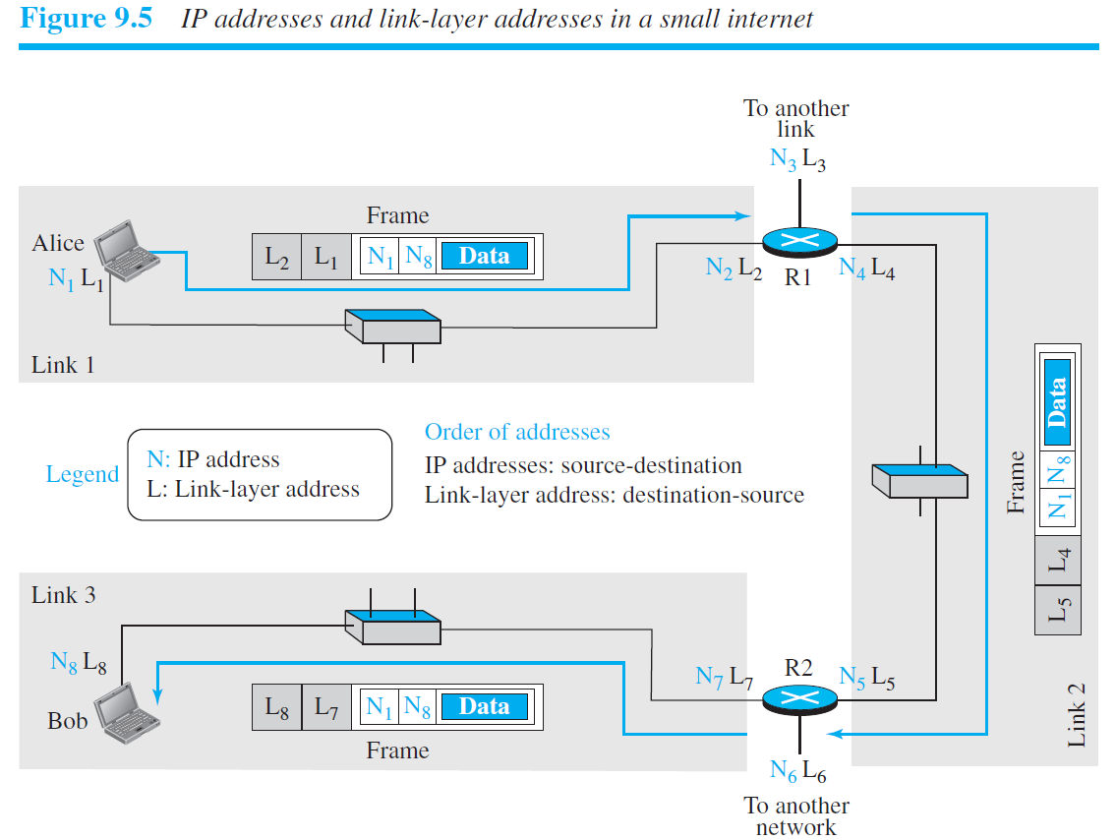

Slide 8
Link Layer Addresses
Unicast: Each host or each interface of a router is assigned a unicast address. Unicasting means one-to-one communication. A3:34:45:11:92:F1 is an example of unicast link-layer address in common LAN or Ethernet. Here 48 bits are presented as 12 hexadecimal digits separated by colons.
Multicast: Multicasting means one-to-many communication. However, the jurisdiction is local (inside the link). Follows similar pattern as unicast but the second digit needs to be an even number in hexadecimal, such as A2:34:45:11:92:F1
Broadcast: Broadcasting means one-to-all communication. A frame with a destination broadcast address is sent to all entities in the link. Here the 48 bits are all 1s, such as FF:FF:FF:FF:FF:FF

Slide 9
Address Resolution Protocol (ARP)
Switches are data-link layer devices that use MAC addresses to forward data to the right destination. (On the other hand, router is a network layer device.)
Address Resolution Protocol (ARP) maps the IP addresses at the network layer to MAC addresses at the data-link layer in an ARP table. This protocol helps a packet at the network layer find the link-layer address of the next node.
If MAC address of the next node is not known to the sender (but IP address is known), sender transmits an ARP broadcast to all nodes in the same network, and only the receiver node responds and shares its MAC address.

Slide 10
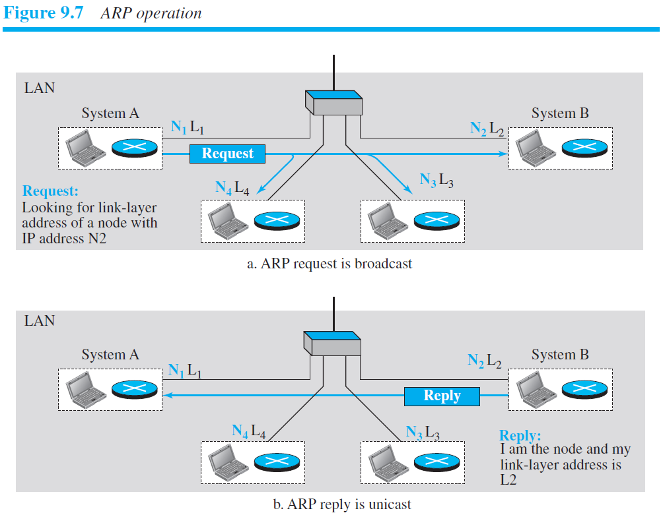
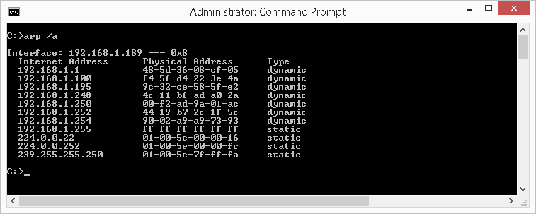

Slide 11
Example
Next, a detailed example of communication between a personal computer and a web server connected to the same network is considered in terms of all TCP/IP layers.
Note that MAC addresses of data-link layer keep changing as a packet travels across links, but the source and destination IP addresses of network layer stays the same.
Additionally, ports are transport layer information that allow data to be directed to or from the correct service.
Encapsulation and decapsulation happens in each node.

Slide 12

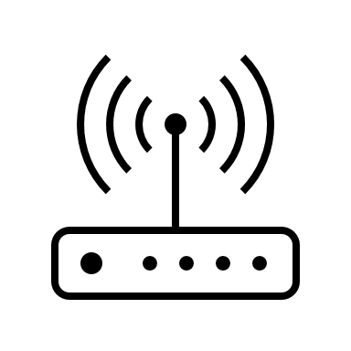
Computers in same network
Sending from my computer → Router
Router IP address: 192.168.1.1
My computer IP address: 192.168.1.21
My computer port: 6457(random)
My computer MAC address:
b7:27:7a:ad:e7:6a
Router MAC address:
17:a5:d0:a0:4c:c7
Web server IP address:
192.168.1.31
Web server port: 8080
Web server MAC address:
af:e3:9b:60:c1:22
LLC: TCP or UDP
Source MAC: b7:27:7a:ad:e7:6a
Destination MAC: 17:a5:d0:a0:4c:c7
Source IP: 192.168.1.21
Destination IP: 192.168.1.31
TTL, Checksum
Source port: 6457
Destination port: 8080
Checksum
Connection request from browser application
Checksum
Ethernet Header
IP header
TCP Header
Message
Ethernet Trailer

Slide 13
Computers in same network
Sending from my computer → Router
Router IP address: 192.168.1.1
My computer IP address: 192.168.1.21
My computer port: 6457(random)
My computer MAC address:
b7:27:7a:ad:e7:6a
Router MAC address:
17:a5:d0:a0:4c:c7
Web server IP address:
192.168.1.31
Web server port: 8080
Web server MAC address:
af:e3:9b:60:c1:22
LLC: TCP or UDP
Source MAC: b7:27:7a:ad:e7:6a
Destination MAC: 17:a5:d0:a0:4c:c7
Source IP: 192.168.1.21
Destination IP: 192.168.1.31
TTL, Checksum
Source port: 6457
Destination port: 8080
Checksum
Connection request from browser application
Checksum
Ethernet Header
IP header
TCP Header
Message
Ethernet Trailer

Slide 14
Computers in same network
Sending from Router → Web Server
Router IP address: 192.168.1.1
My computer IP address: 192.168.1.21
My computer port: 6457(random)
My computer MAC address:
b7:27:7a:ad:e7:6a
Router MAC address:
17:a5:d0:a0:4c:c7
Web server IP address:
192.168.1.31
Web server port: 8080
Web server MAC address:
af:e3:9b:60:c1:22
LLC info +
Source MAC: 17:a5:d0:a0:4c:c7
Destination MAC: af:e3:9b:60:c1:22
Source IP: 192.168.1.21
Destination IP: 192.168.1.31
TTL, Checksum
Source port: 6457
Destination port: 8080
Checksum
Connection request from browser application
Checksum
Ethernet Header
IP header
TCP Header
Message
Ethernet Trailer

Slide 15
Computers in same network
Once Web Server has received
Router IP address: 192.168.1.1
My computer IP address: 192.168.1.21
My computer port: 6457(random)
My computer MAC address:
b7:27:7a:ad:e7:6a
Router MAC address:
17:a5:d0:a0:4c:c7
Web server IP address:
192.168.1.31
Web server port: 8080
Web server MAC address:
af:e3:9b:60:c1:22
LLC info +
Source MAC: 17:a5:d0:a0:4c:c7
Destination MAC: af:e3:9b:60:c1:22
Source IP: 192.168.1.21
Destination IP: 192.168.1.31
TTL, Checksum
Source port: 6457
Destination port: 8080
Checksum
Connection request from browser application
Checksum
Ethernet Header
IP header
TCP Header
Message
Ethernet Trailer

Slide 16
Computers in same network
Web Server -> Router
Router IP address: 192.168.1.1
My computer IP address: 192.168.1.21
My computer port: 6457(random)
My computer MAC address:
b7:27:7a:ad:e7:6a
Router MAC address:
17:a5:d0:a0:4c:c7
Web server IP address:
192.168.1.31
Web server port: 8080
Web server MAC address:
af:e3:9b:60:c1:22
LLC info +
Source MAC: af:e3:9b:60:c1:22
Destination MAC: 17:a5:d0:a0:4c:c7
Source IP: 192.168.1.31
Destination IP: 192.168.1.21
TTL, Checksum
Source port: 8080
Destination port: 6457
Checksum
Data from web page on server
Checksum
Ethernet Header
IP header
TCP Header
Message
Ethernet Trailer

Slide 17
Computers in same network
Router->My Computer
Router IP address: 192.168.1.1
My computer IP address: 192.168.1.21
My computer port: 6457(random)
My computer MAC address:
b7:27:7a:ad:e7:6a
Router MAC address:
17:a5:d0:a0:4c:c7
Web server IP address:
192.168.1.31
Web server port: 8080
Web server MAC address:
af:e3:9b:60:c1:22
LLC info +
Source MAC: af:e3:9b:60:c1:22
Destination MAC: 17:a5:d0:a0:4c:c7
Source IP: 192.168.1.31
Destination IP: 192.168.1.21
TTL, Checksum
Source port: 8080
Destination port: 6457
Checksum
Data from web page on server
Checksum
Ethernet Header
IP header
TCP Header
Message
Ethernet Trailer

Slide 18
Computers in same network
Router->My Computer
Router IP address: 192.168.1.1
My computer IP address: 192.168.1.21
My computer port: 6457(random)
My computer MAC address:
b7:27:7a:ad:e7:6a
Router MAC address:
17:a5:d0:a0:4c:c7
Web server IP address:
192.168.1.31
Web server port: 8080
Web server MAC address:
af:e3:9b:60:c1:22
LLC info +
Source MAC: 17:a5:d0:a0:4c:c7 Destination MAC:
b7:27:7a:ad:e7:6a
Source IP: 192.168.1.31
Destination IP: 192.168.1.21
TTL, Checksum
Source port: 8080
Destination port: 6457
Checksum
Data from web page on server
Checksum
Ethernet Header
IP header
TCP Header
Message
Ethernet Trailer

Slide 19
Computers in same network
Once My Computer has received
Router IP address: 192.168.1.1
My computer IP address: 192.168.1.21
My computer port: 6457(random)
My computer MAC address:
b7:27:7a:ad:e7:6a
Router MAC address:
17:a5:d0:a0:4c:c7
Web server IP address:
192.168.1.31
Web server port: 8080
Web server MAC address:
af:e3:9b:60:c1:22
LLC info +
Source MAC: 17:a5:d0:a0:4c:c7 Destination MAC:
b7:27:7a:ad:e7:6a
Source IP: 192.168.1.31
Destination IP: 192.168.1.21
TTL, Checksum
Source port: 8080
Destination port: 6457
Checksum
Data from web page on server
Checksum
Ethernet Header
IP header
TCP Header
Message
Ethernet Trailer

Slide 20
Computers in same network
Once My Computer has received
Router IP address: 192.168.1.1
My computer IP address: 192.168.1.21
My computer port: 6457(random)
My computer MAC address:
b7:27:7a:ad:e7:6a
Router MAC address:
17:a5:d0:a0:4c:c7
Web server IP address:
192.168.1.31
Web server port: 8080
Web server MAC address:
af:e3:9b:60:c1:22
LLC info +
Source MAC: 17:a5:d0:a0:4c:c7 Destination MAC:
b7:27:7a:ad:e7:6a
Source IP: 192.168.1.31
Destination IP: 192.168.1.21
TTL, Checksum
Source port: 8080
Destination port: 6457
Checksum
Data from web page on server
Checksum
Ethernet Header
IP header
TCP Header
Message
Ethernet Trailer

